Slide 1

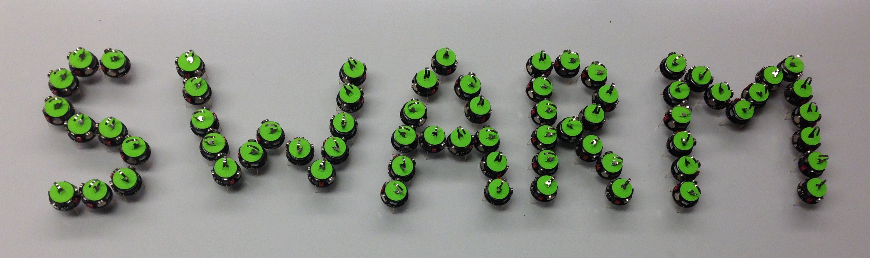
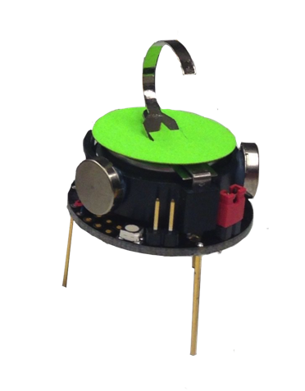







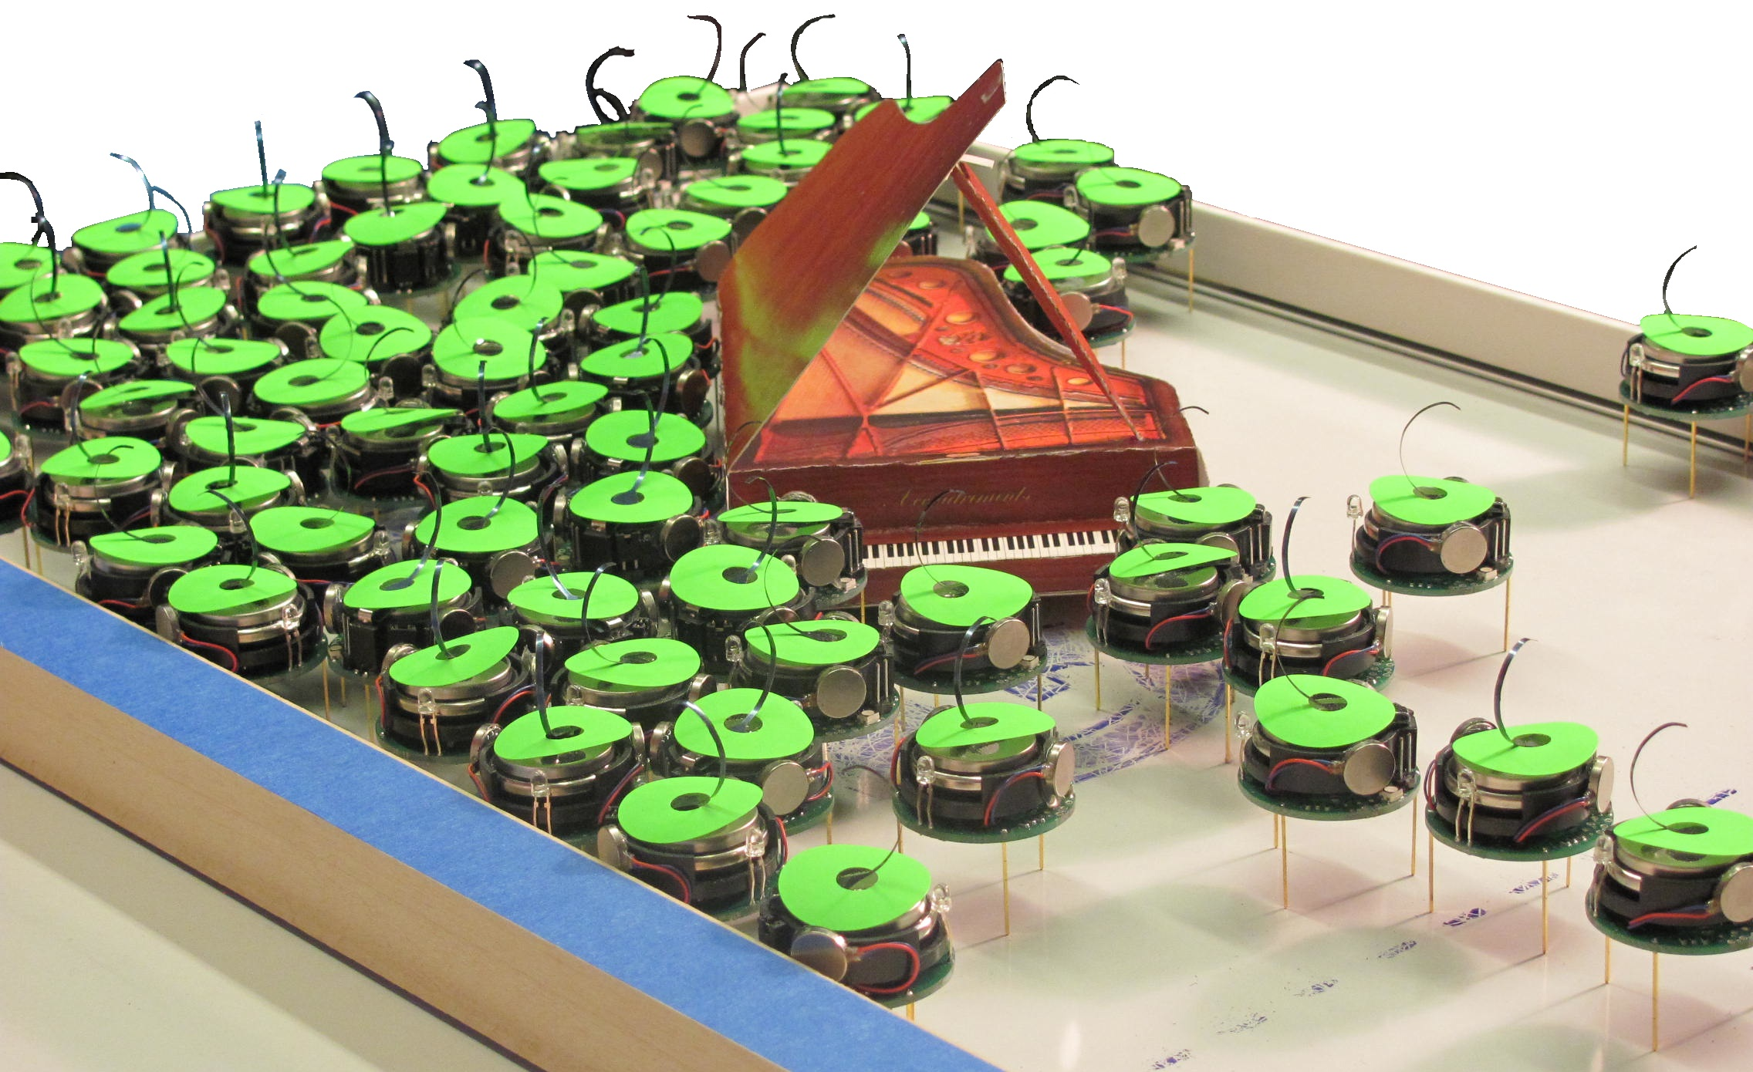
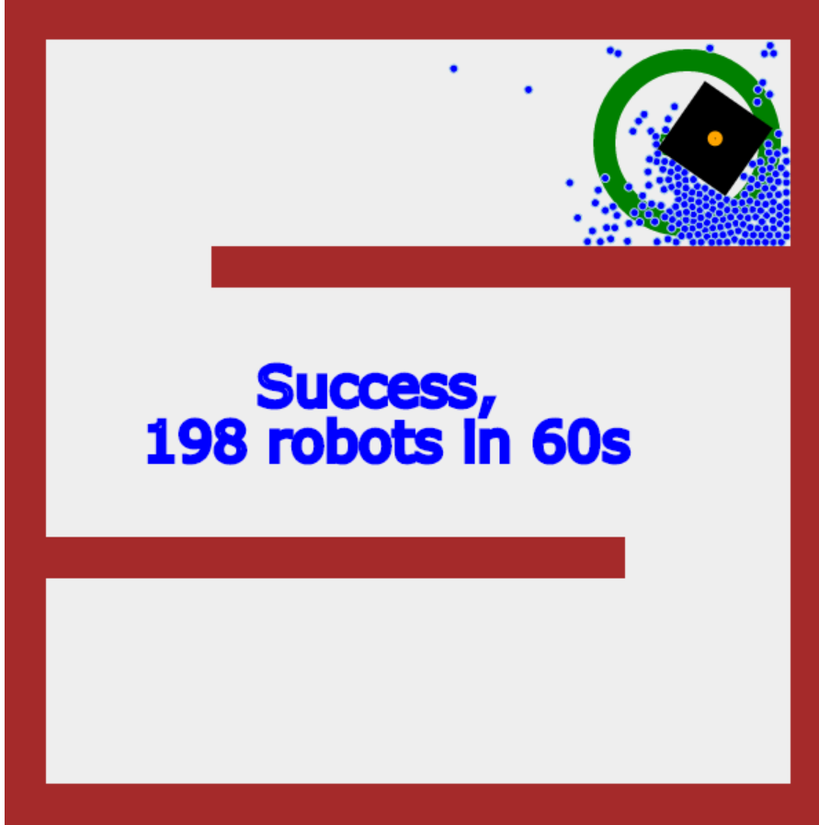
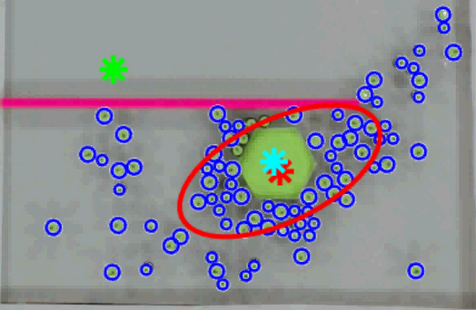
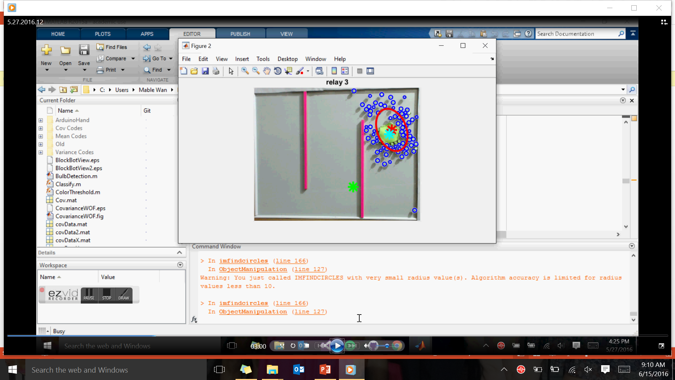
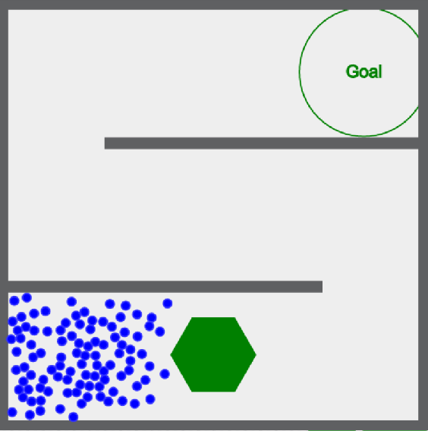

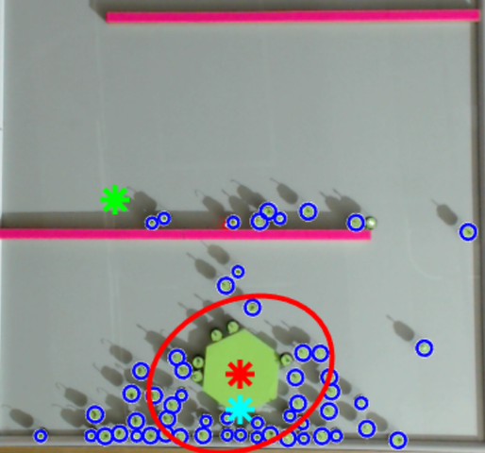
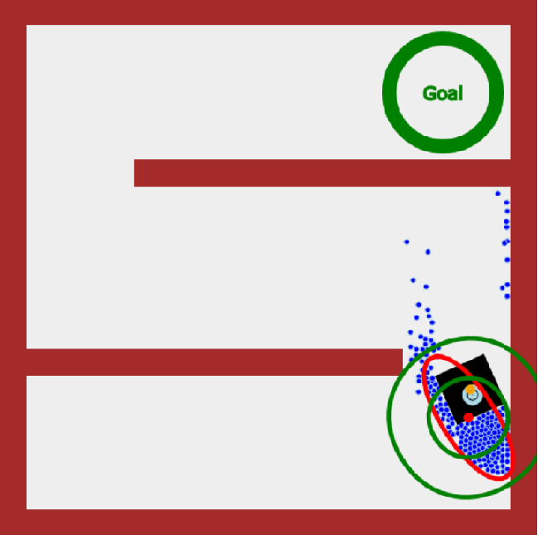
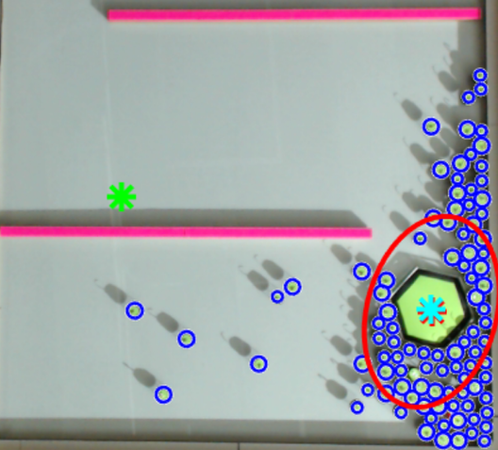
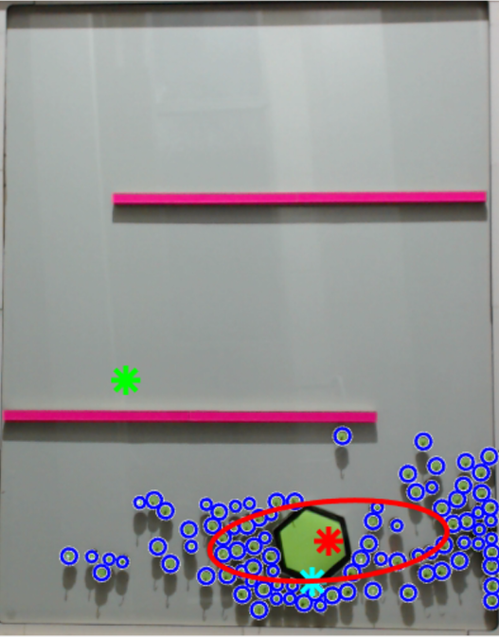
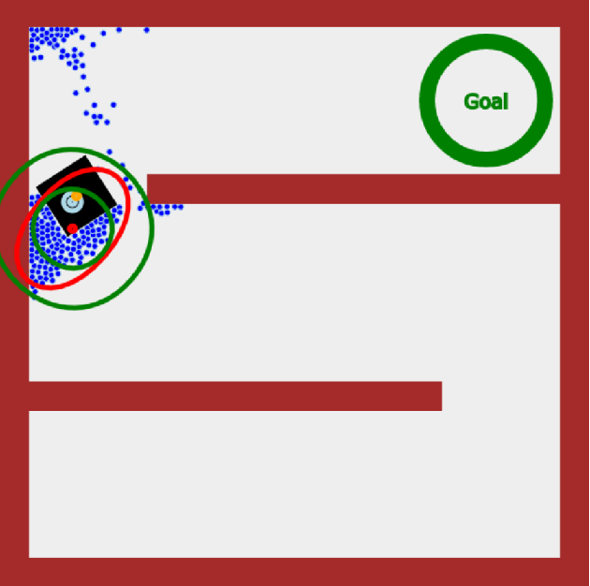

SWARM Object Manipulation
with Local Mean Control
Shiva Shahrokhi, Mable Wan, Lillian Lin, and Aaron T. Becker
sshahrokhi2@uh.edu mmwan2@uh.edu lklin@uh.edu atbecker@uh.edu .
Shiva Shahrokhi Mable Wan Lillian Lin
Dr. Becker
Actual Size
What is SWARM?
Problem
Results
SWARM is 100+ kilo-bots moving an object to a desired location. All robots have the same “brain”, aka program, and respond to the same global inputs, the brightest lights.
Advantages of SWARM:
Can pass through tight structures
Can bend around obstacles
Affordable to replace the robots
Control variables: Mean and Variance
Centroid Matching
False goal completion
Robots go in loops trying to follow local goal.
Robots and object get “stuck” in that place
Concept successful in simulation!
Increases probability
of reaching the goal in experiments.
Reduces noise for
calculating desired
direction for robots
Decreases chances of
the block getting stuck
Local Goal
Mean
Robot Direction
Direction #1
Direction #2
Solution
Object’s
Centroid/ Local Goal
Conclusions
Ideal Direction
Local Mean Control
Consider only relevant robots
Mean
Obstacle Considerations
are Necessary
Obstacles create irrelevant robots that hinder object’s movement
Local Control is
More Effective
Peripheral data induces noise in calculations
Local control demonstrates the ranges of radii that affect the object differently
Variance
Method
Calculates the mean of the robots within a certain radius, the relevant robots.
Problem
Irrelevant Robots
Main Problem: Considering all the robots in the mean calculation hinders the object’s ideal movements to the goal.
Relevant Robots
Irrelevant Robots
Robots in front of the object
Blocks object from moving in desired direction
Pushes object further away from the goal when ideal direction is going left.
Goal
Mean calculations successfully exclude:
Robots that are stuck behind obstacles
Robots that are in front of object
Irrelevant
Robots
Irrelevant Robots
Games
Ideal Direction
Relevant Robots
Play games for our research!
Mean
Swarmcontrol.net

